Slide 1


Adaptive Cruise Control Using LIDAR
Priyank Kalgaonkar
Kavyashree Prasad S P
Arjun Narukanchira Anilkumar
Department of Electrical and Computer Engineering at IUPUI
ECE 595 Project #1 Presentation - Group 3
March 23, 2020

Slide 2
1.
Introduction
Adaptive Cruise Control Using LIDAR

Slide 3
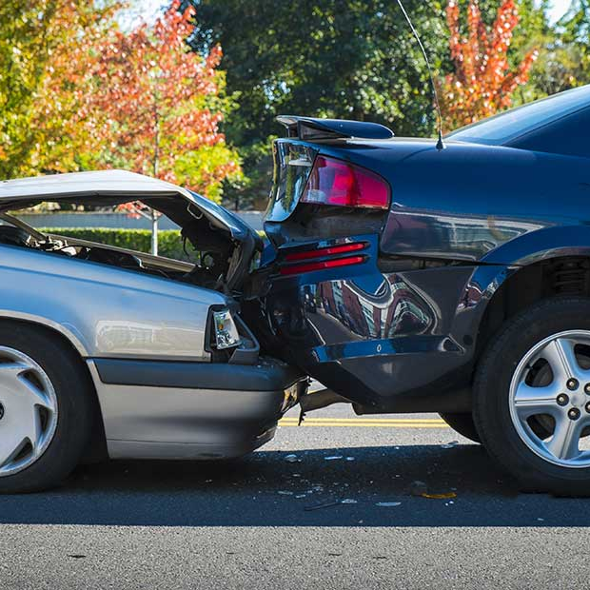
Need
Traditional cruise control system cannot slow down or speed up the vehicle contributing to a substantial number of injuries and fatalities each year caused by rear-end collisions.
Of these nearly 2 million accidents, about 1,700 people die and another 500,000 are injured in these types of crashes.

Slide 4
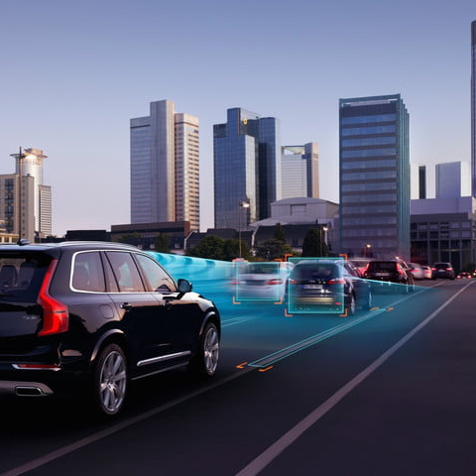
Objective
To enable the traditional cruise control system to automatically slow down or speed up the vehicle up to a speed limit set by the driver and maintain a safe distance with traffic up ahead.

Slide 5
2.
System Design
Adaptive Cruise Control Using LIDAR

Slide 6
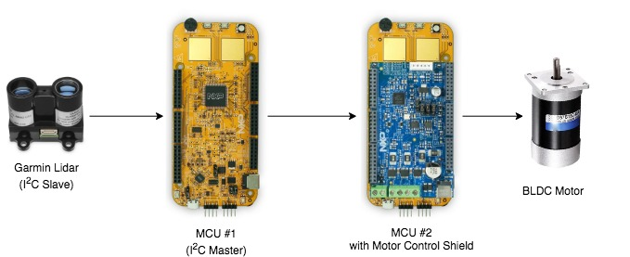
High Level Design

Slide 7
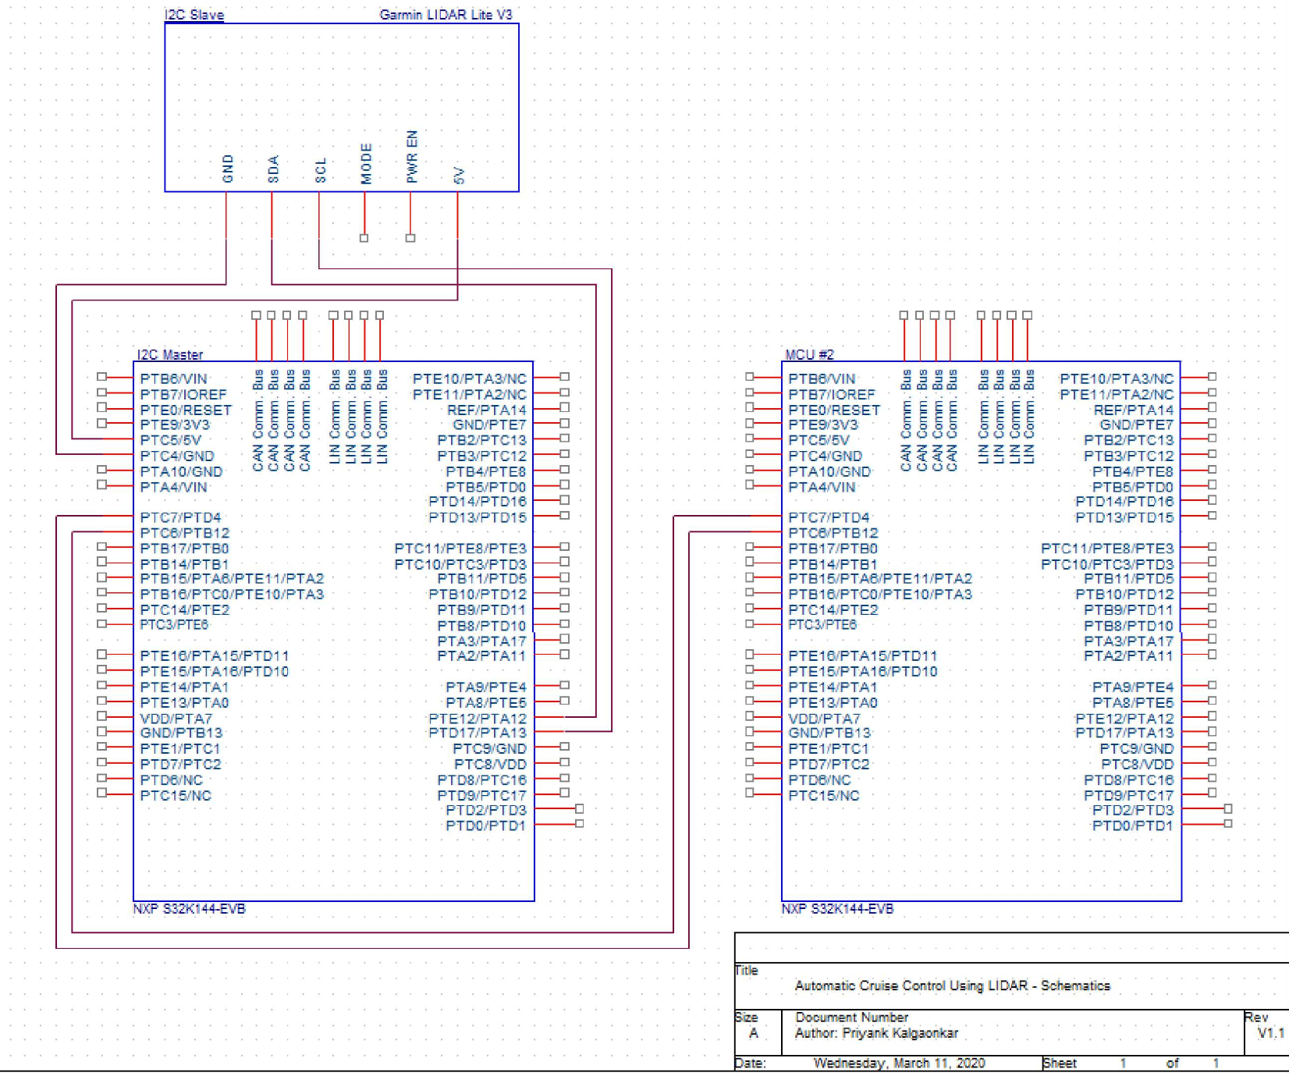
System Schematics

Slide 8
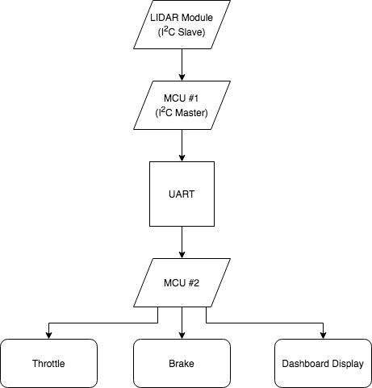
Data Flow Diagram

Slide 9
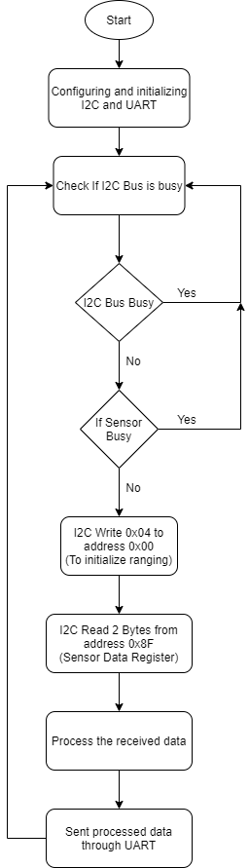
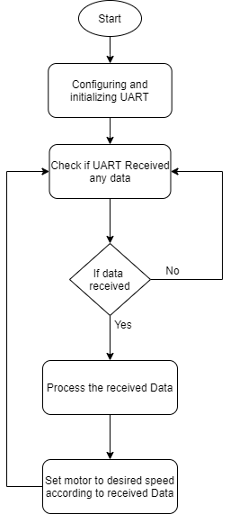
Software Design Flow Charts

Slide 10
3.
Results
Adaptive Cruise Control Using LIDAR

Slide 11
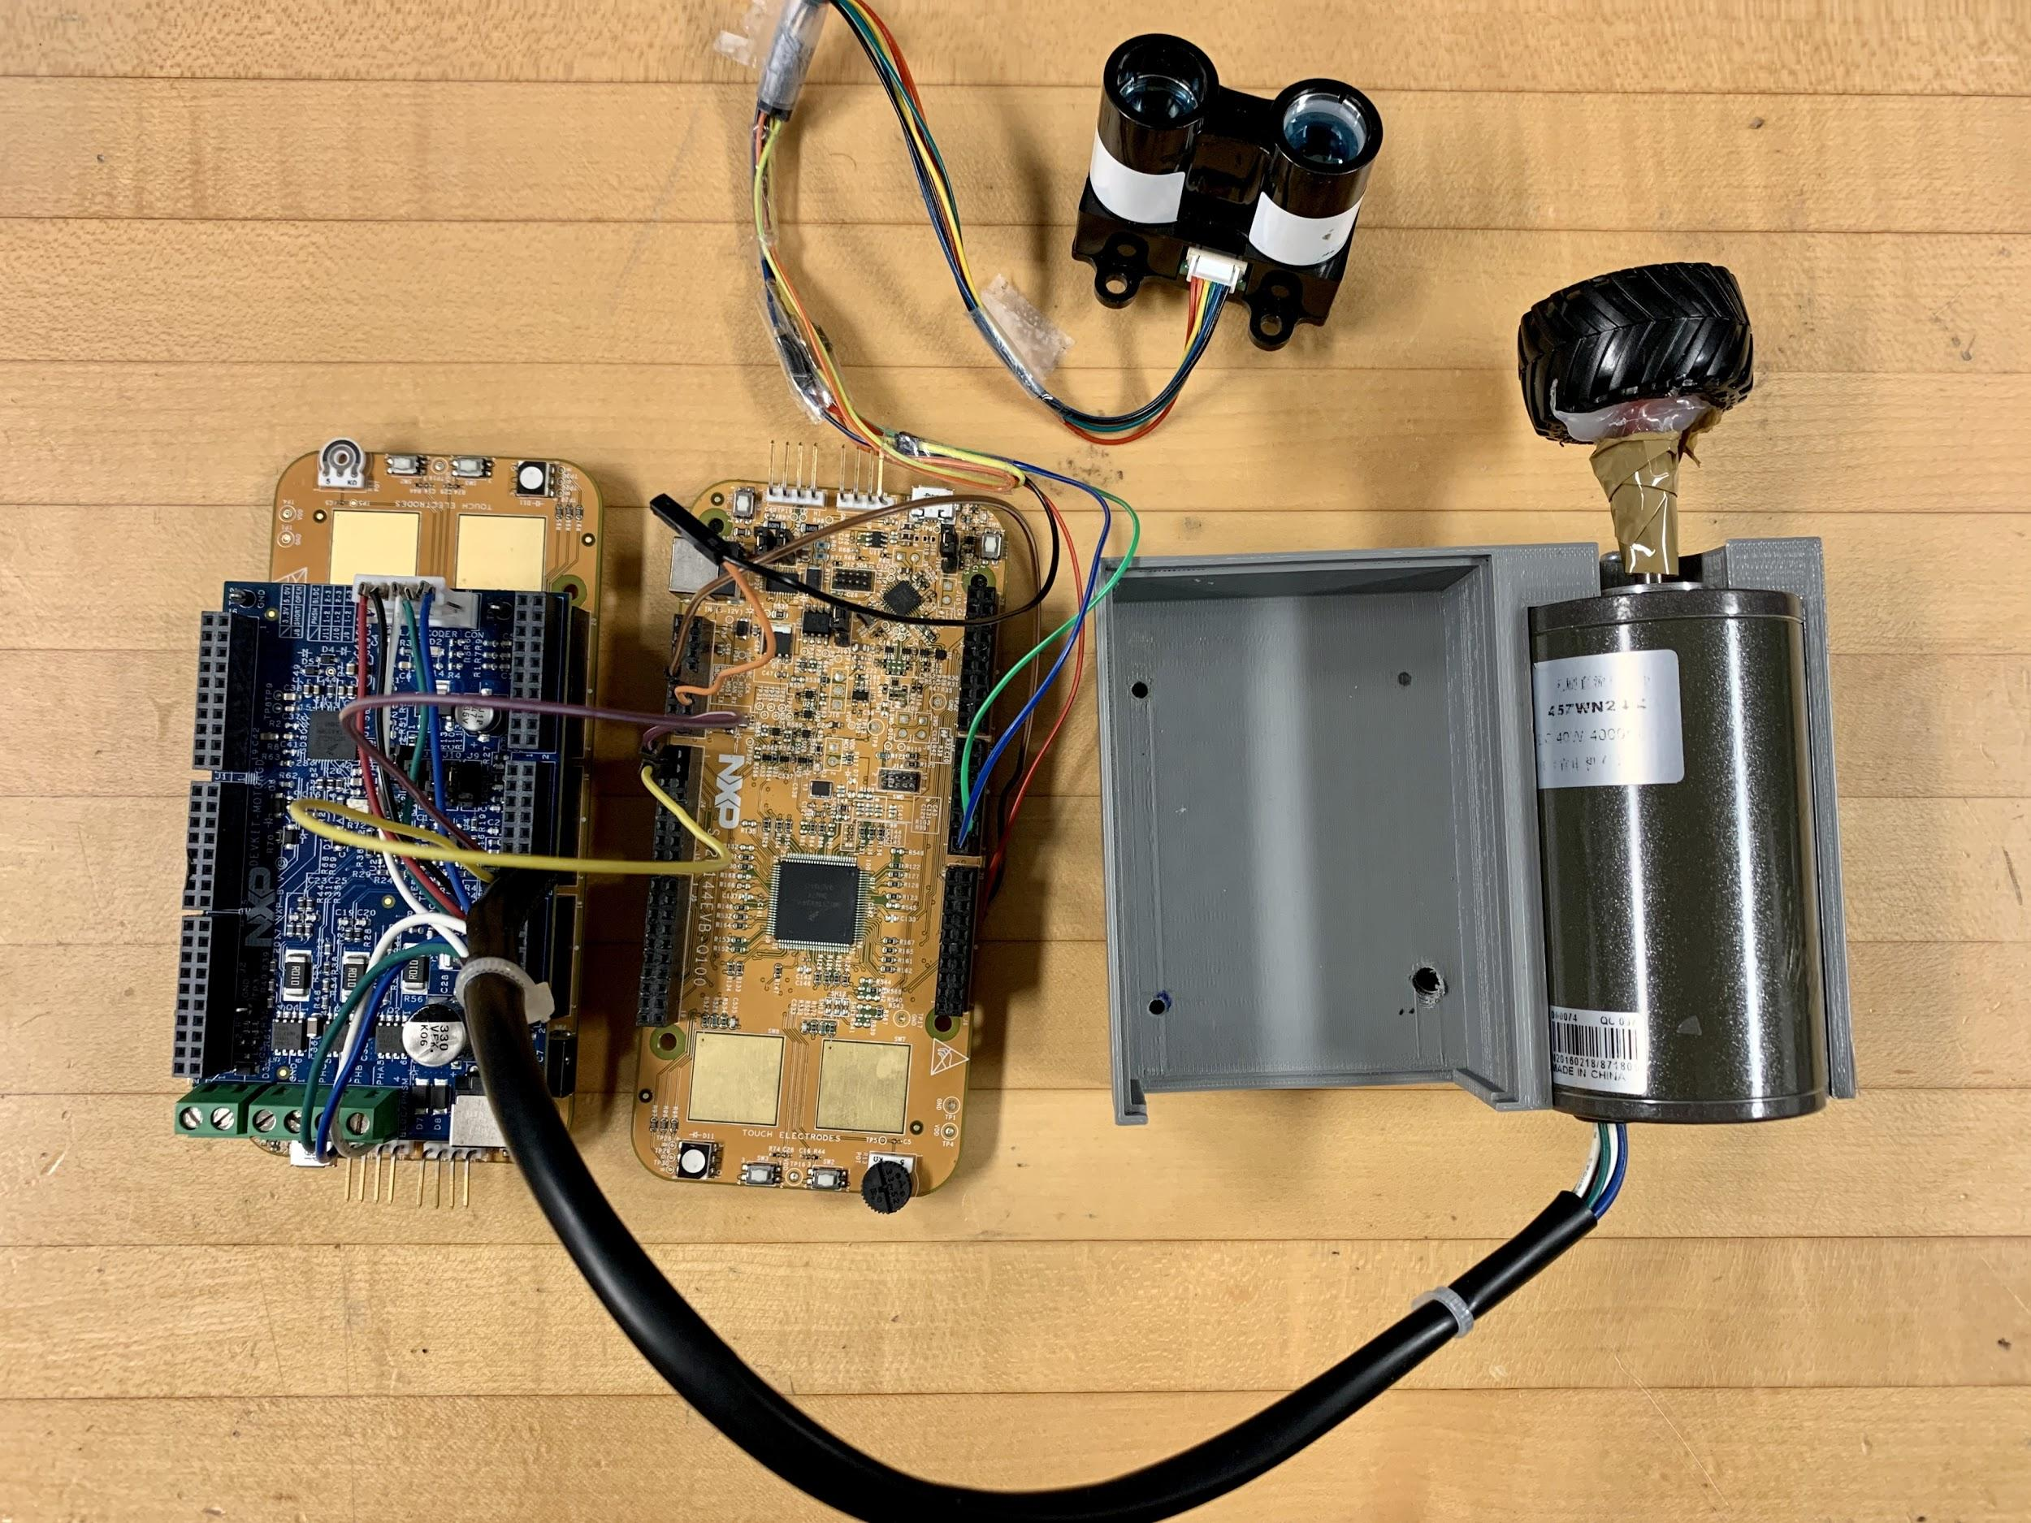
Our Working Prototype

Slide 12
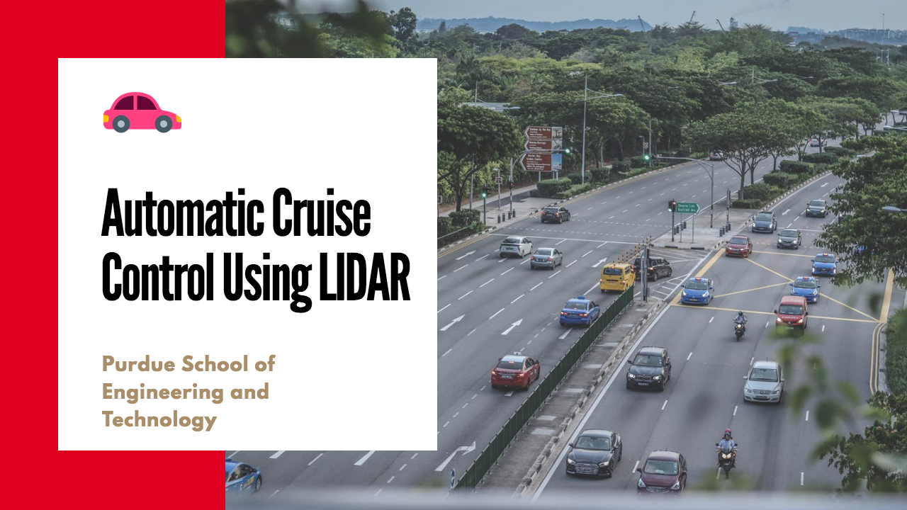
Video Demonstration
YouTube Video Link: https://youtu.be/jsxPeRWvAOA

Slide 13
4.
Conclusion
Adaptive Cruise Control Using LIDAR

Slide 14
Conclusion
Processing is done in real-time and quickly (<1s).
Data from LIDAR module automatically controls the motor's speed.
Improved safety and ride comfort is achieved whilst maintaining good fuel economy.

Slide 15
Recommendations for Future Work
For future work, we recommend using CAN communication protocol combining our system with cameras, multiple sensors and computer vision processing to pave way for this system into the autonomous world of trucks and automobiles.

Slide 16
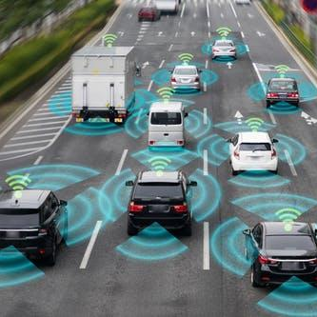
Thanks!
Any Questions?
Project: Adaptive Cruise Control Using LIDAR.
By: Priyank Kalgaonkar, Kavyashree Prasad, Arjun Narukanchira Anilkumar.

